Slide 1

A VERY GOOD MORNING FROM ALL OF US AT

Slide 2
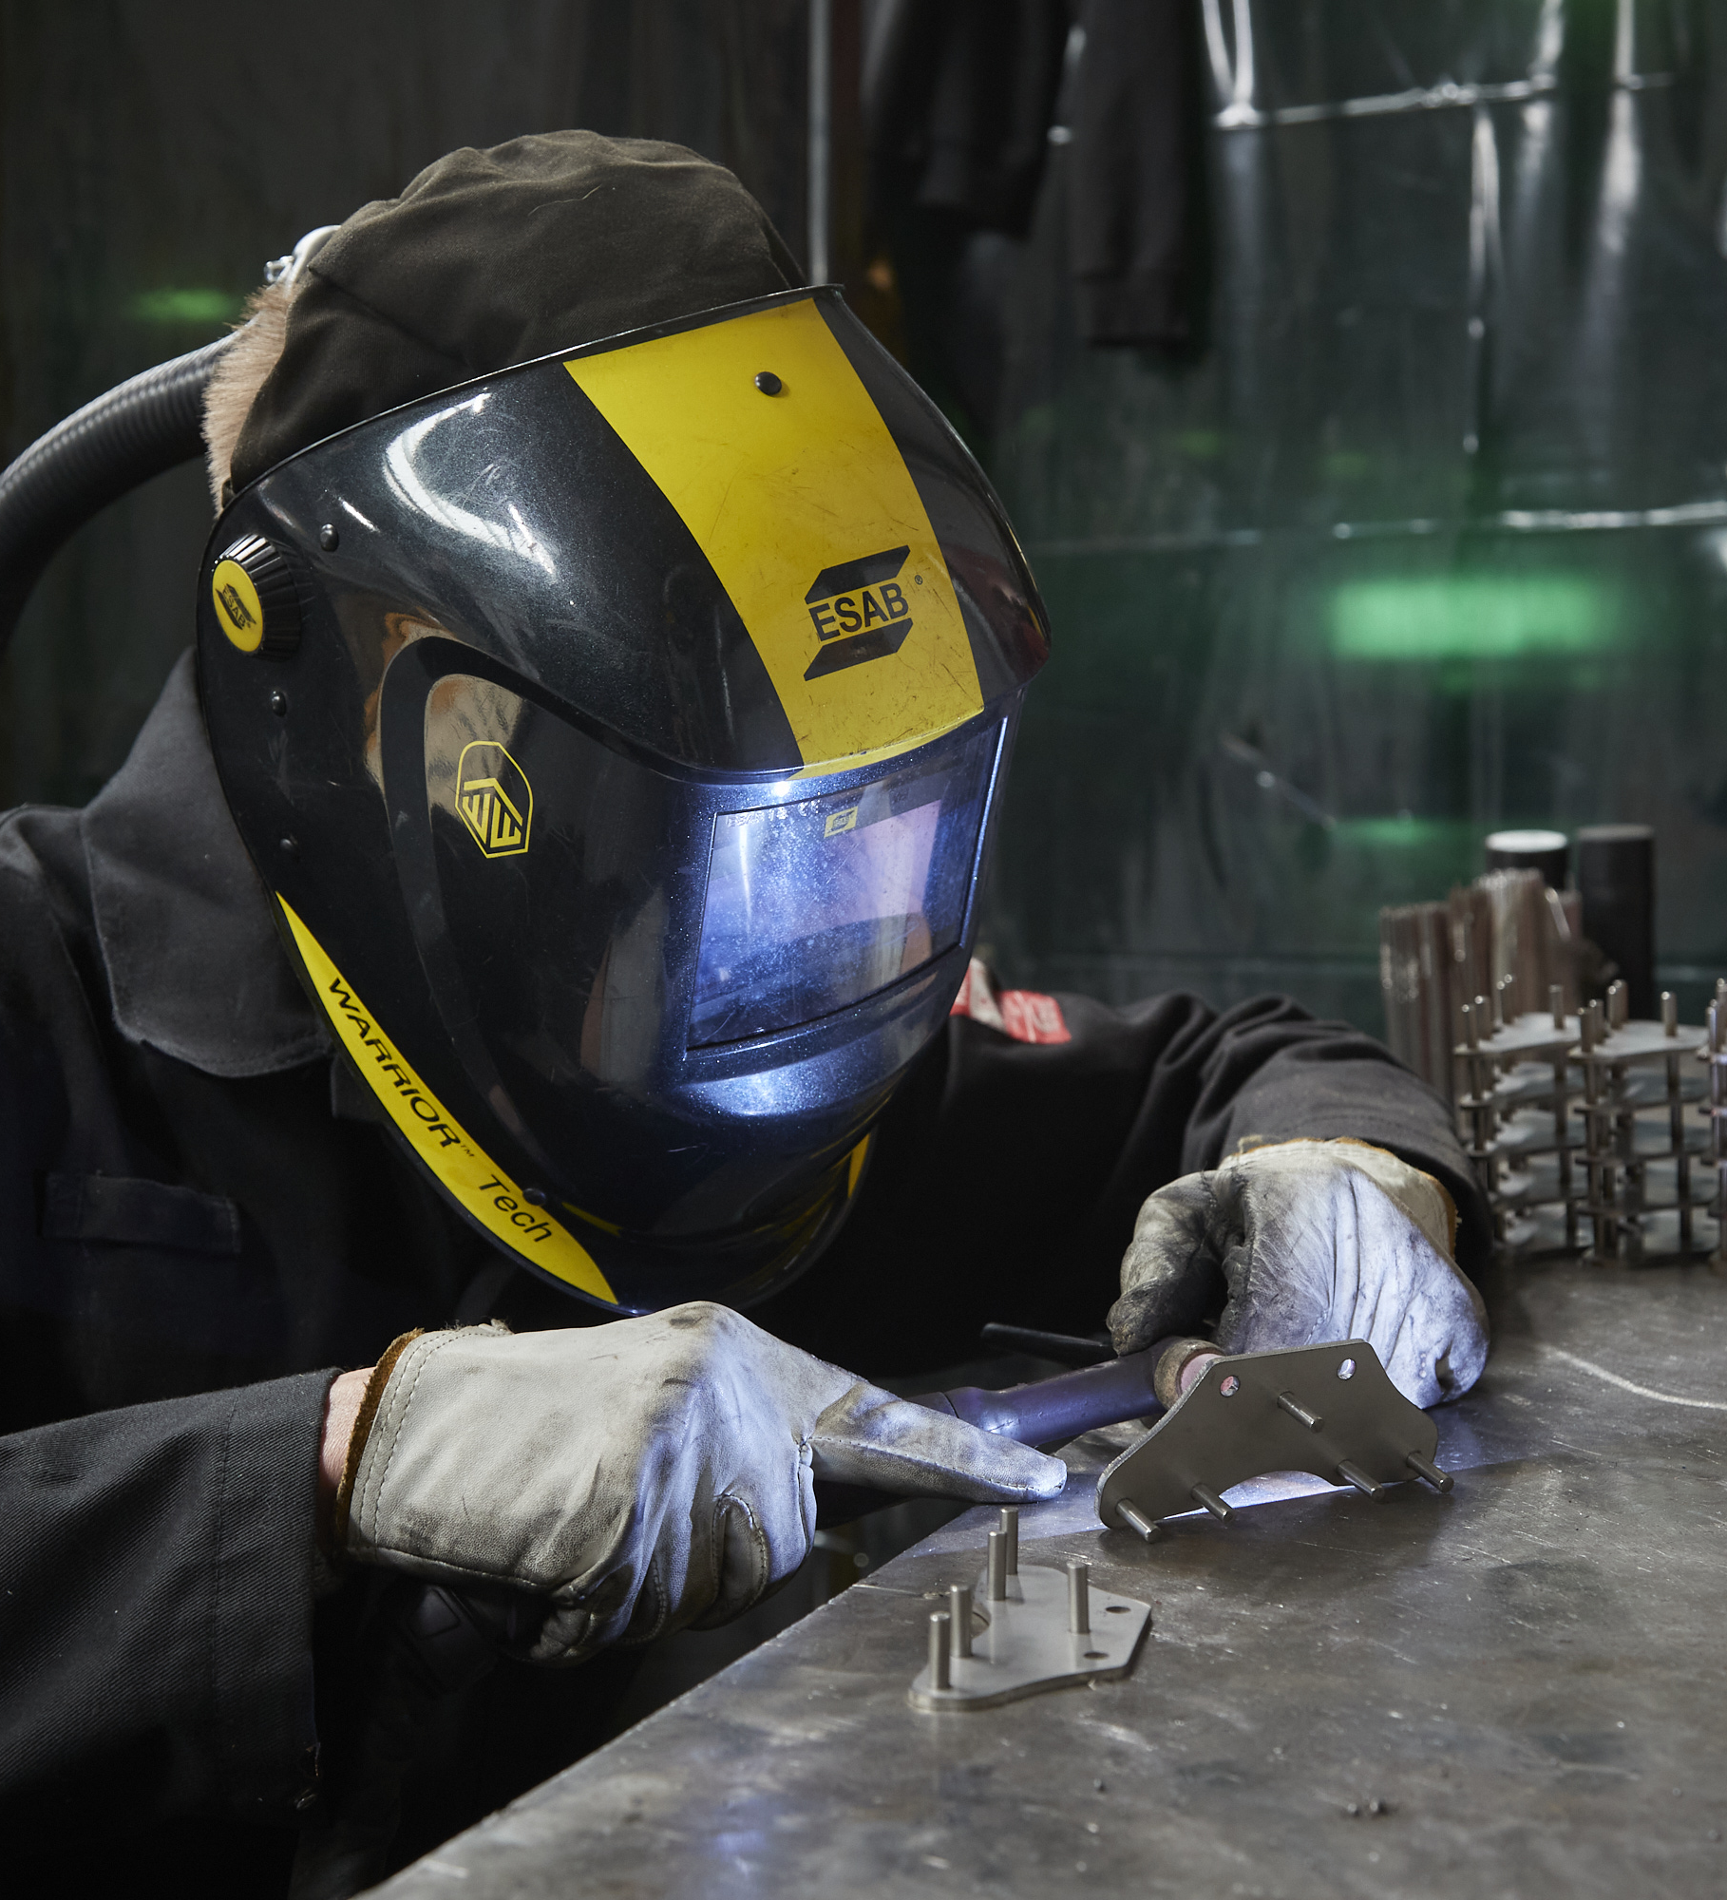
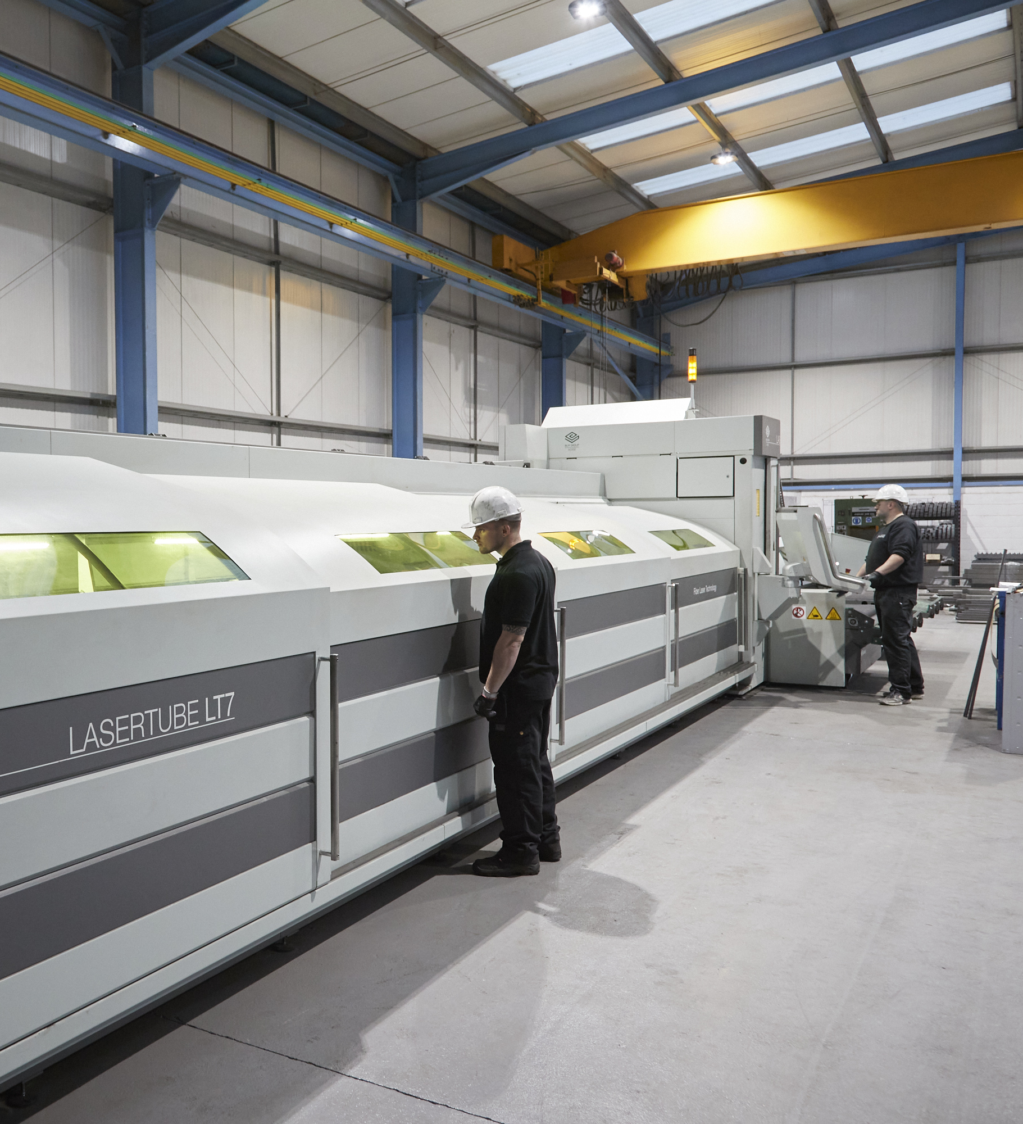
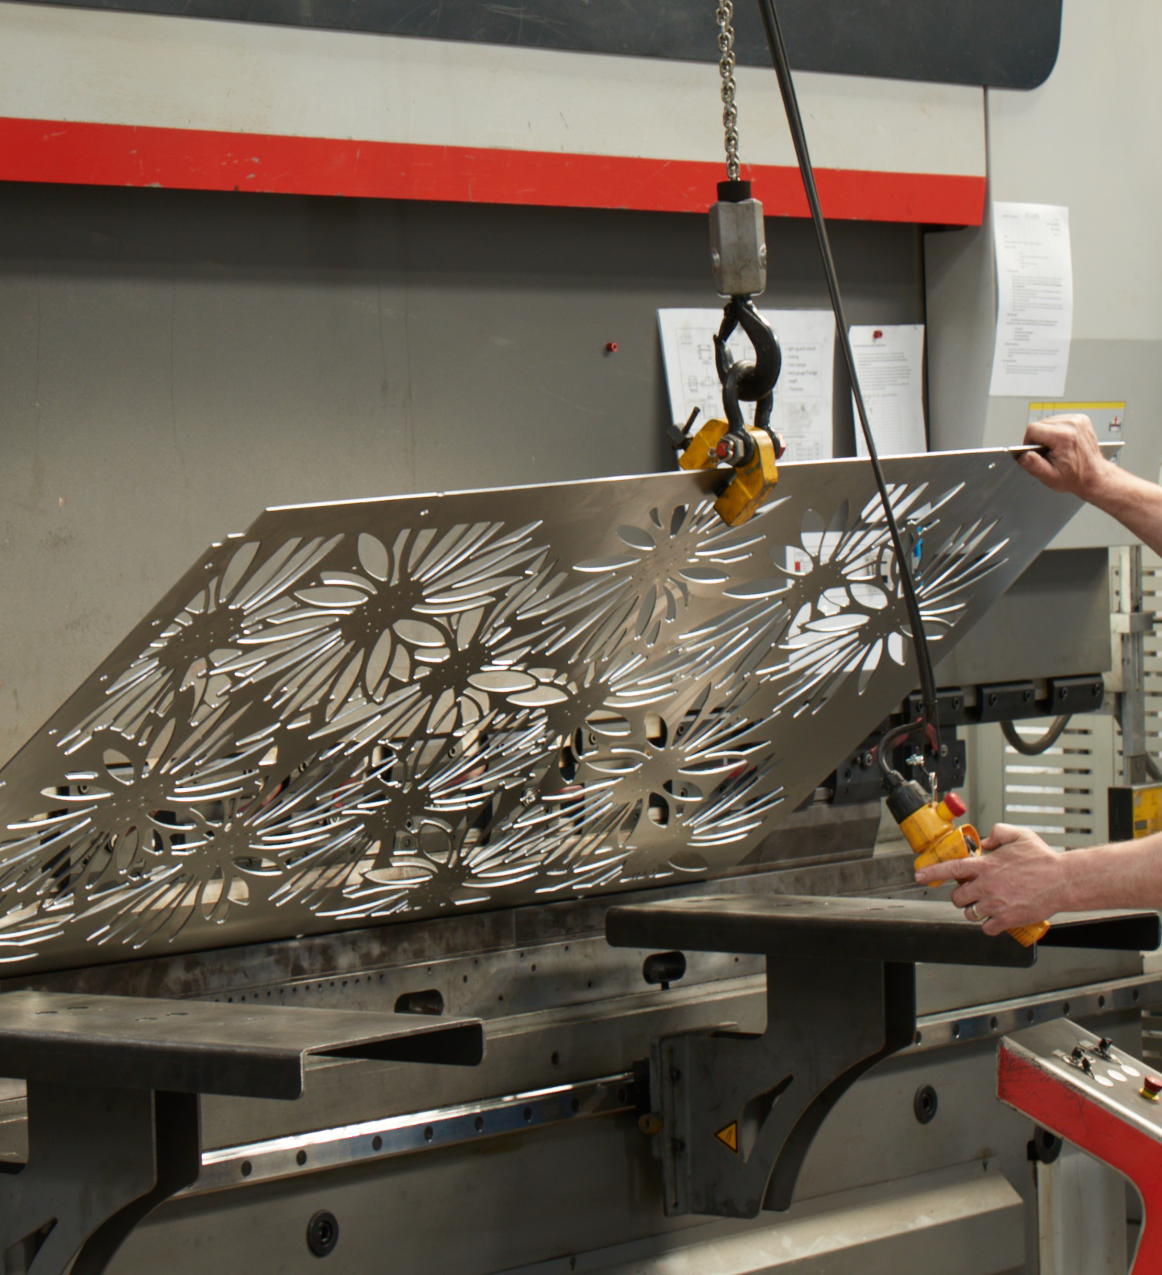
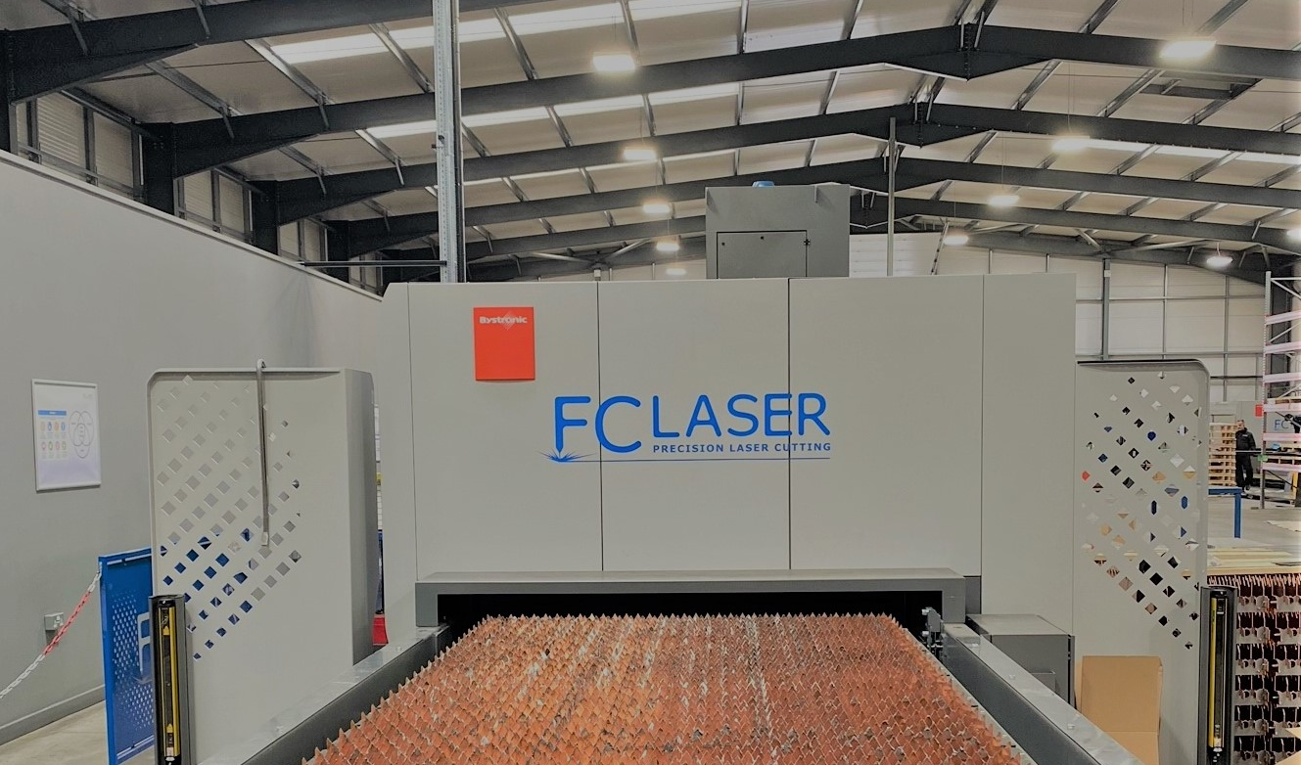
“Our company goal is to offer a world class service to all customers. From a rapid response to any enquiry, to the quick and safe delivery of ordered parts.” Danny Fantom MD
INTRODUCTIONS

Slide 3
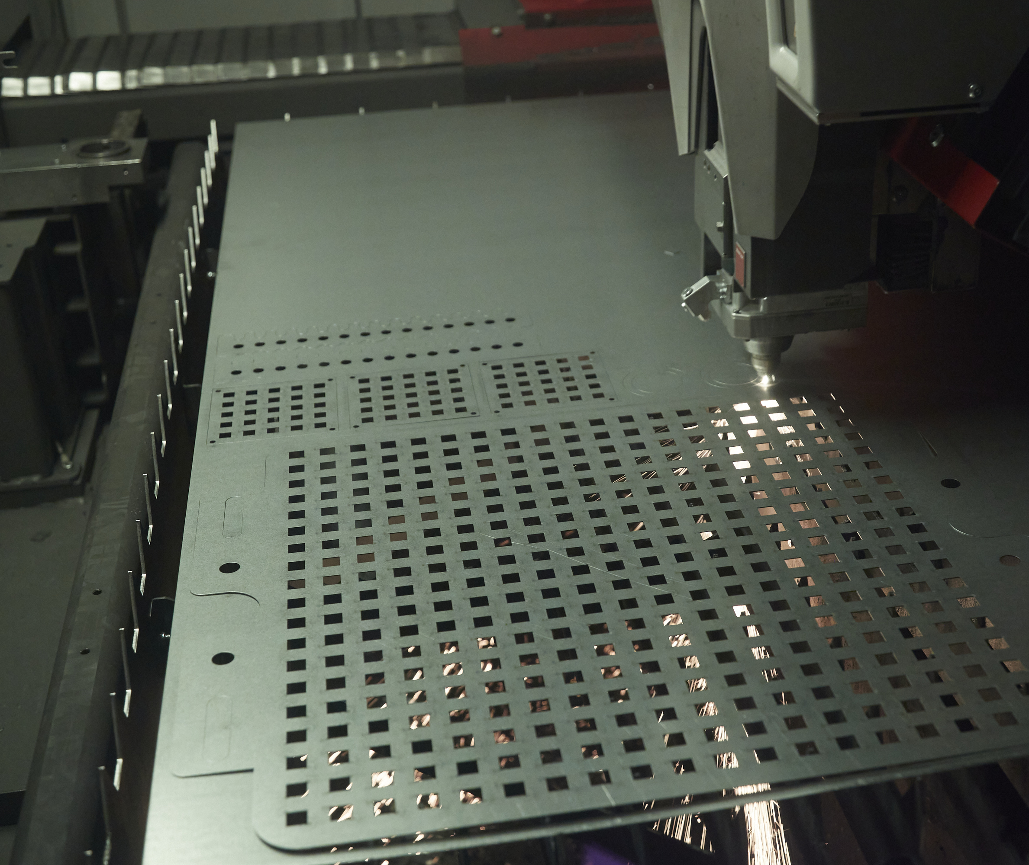
FIBRE LASER CUTTING
TWO 10Kw BYSTRONIC BYSTAR LASERS
TWO 12Kw BYSTRONIC BYSTAR LASERS
BYTRANS LOADING BED
ONE 4X2M SHEET BED

Slide 4
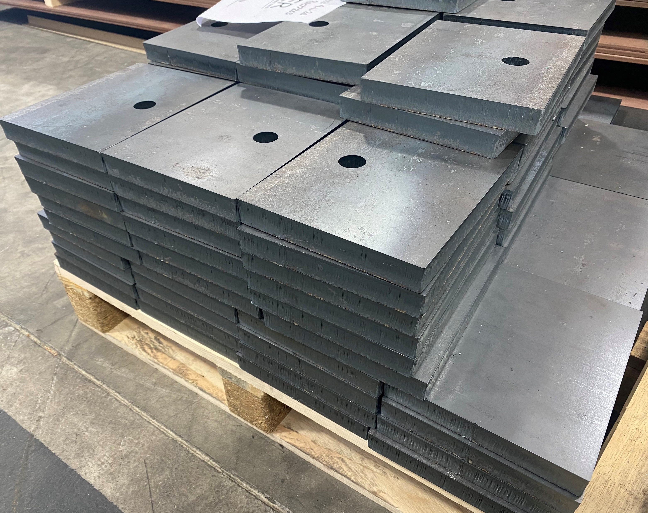
FIBRE LASER ADVANTAGES
“With the very latest Bystronic 12Kw CO2 and Fibre Laser Cutting Machines we are in the enviable position to offer the very highest cutting standards at competitive prices”
Quality
great edge quality in 20 – 30mm mild steel – Easy part removal
Accuracy
+/- 0.2MM measurement tolerances as standard
Speed
Ability to cut 30mm mild steel up to 20% faster*
Power
Easily cuts through thicknesses of 25 mm mild steel; 30 mm stainless steel; 30 mm aluminium; 15 mm copper and 12 mm brass
* 12Kw Automatic Nozzle changing facility allows for constant cutting of sheets, without manual interruption

Slide 5
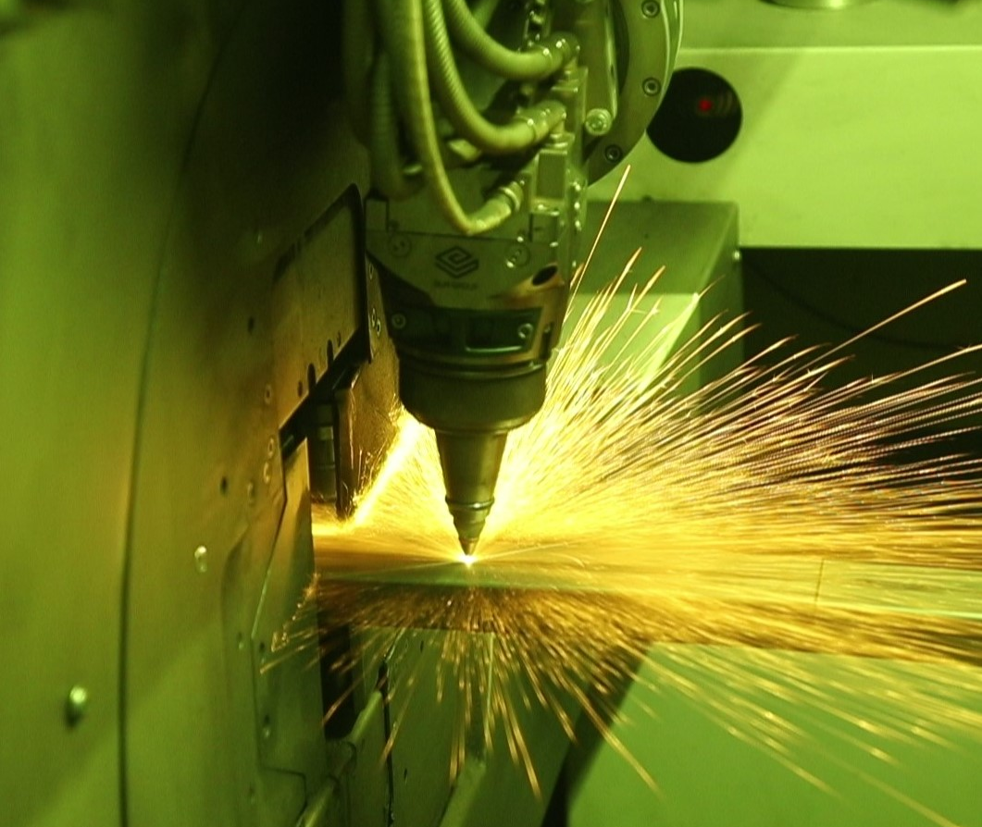
3D FIBRE LASER CUTTING
ONE BLM GROUP LASERTUBE LT7
AUTOMATIC TUBE LOADING BED
ACTIVE MATERIAL SCAN
COMMON STOCK HELD BY FC LASER

Slide 6
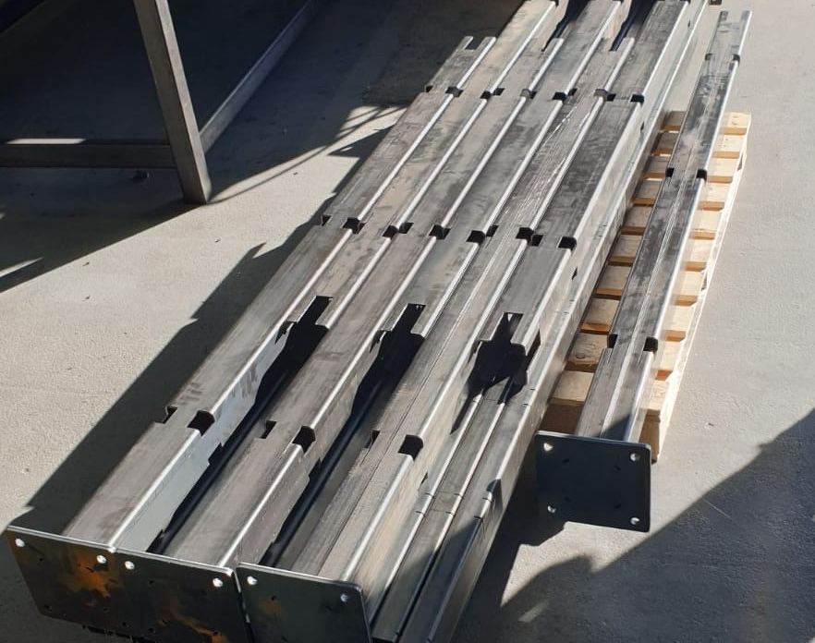
LT7 TOLERANCES
“The LT7 fiber tube laser is by far the most complete and advanced laser cutting tube on the market today. Our facility perfectly balances efficiency in production and quality.”
Tube diameter (mm) 12-152
Bar length (m) 6.5
Bar weight (kg/m) 23
Unloadable part length (m) 4.5 - 6.5
Laser source power (kW) 3
Fully automatic loading
Materials: mild steel, stainless steel, aluminum, copper, brass
2D and 3D jobs

Slide 7
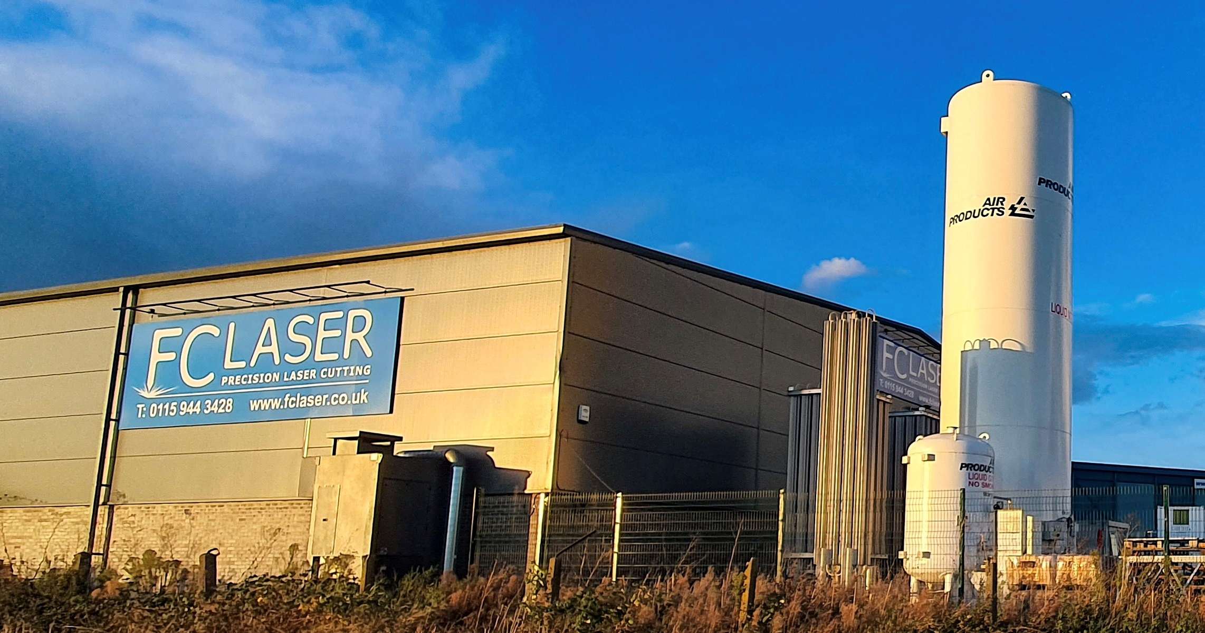
WELCOME TO OUR SITE

Slide 8
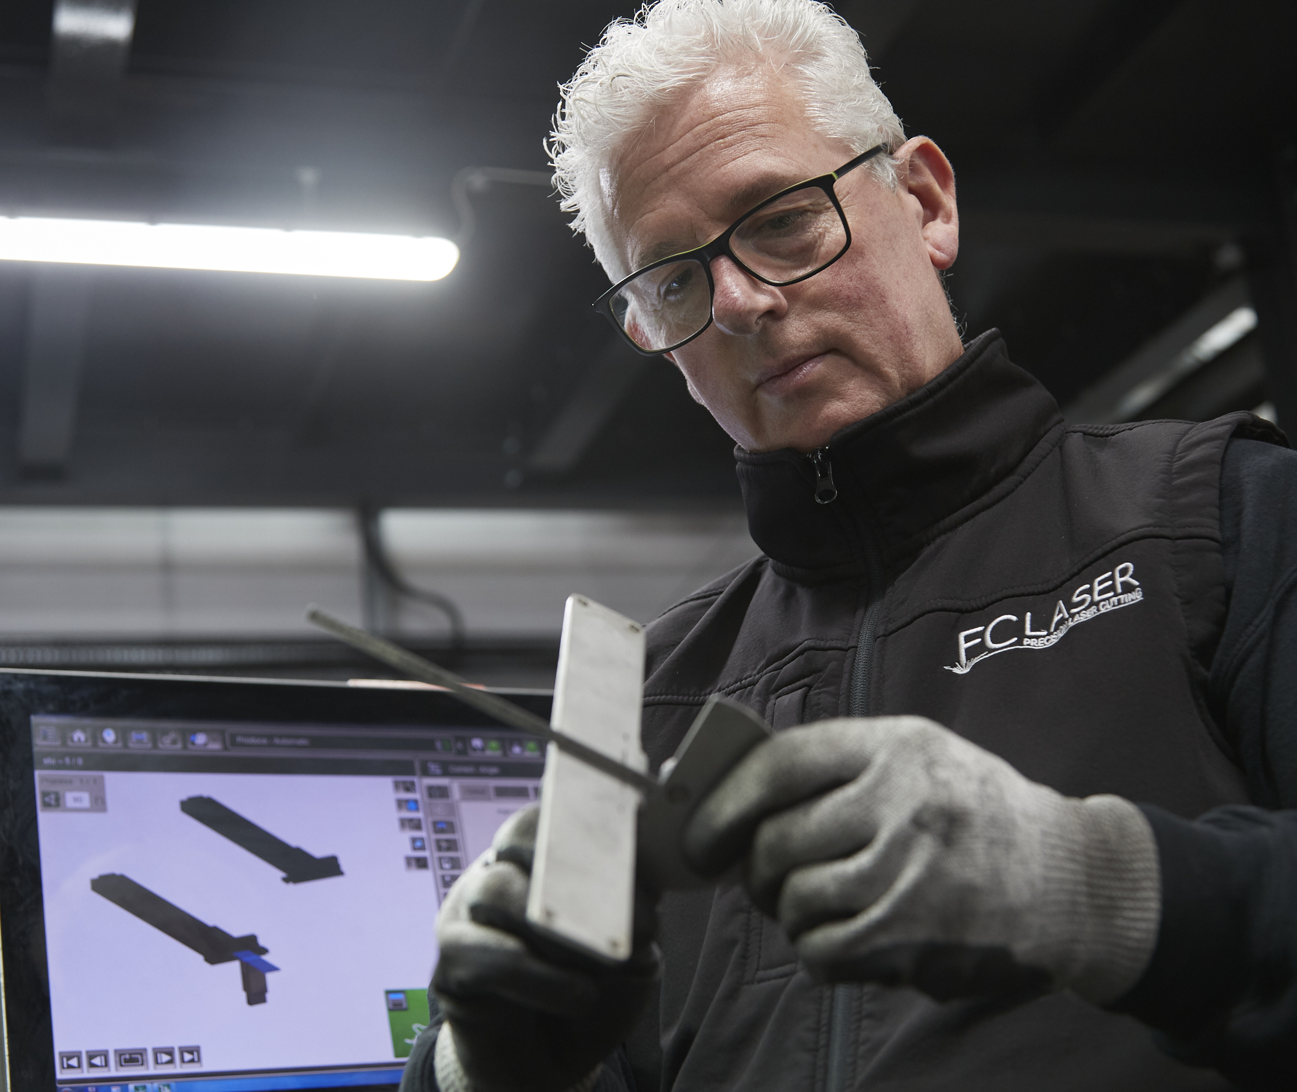
FOLDING & FURTHER OPERATIONS
Five Bystronic Xpert press brakes
One Pemserter Series 4
Two XYZ fast tap
3 Welding bays
Two Radial arms for Drilling & Countersinking
Onsite Deburring

Slide 9
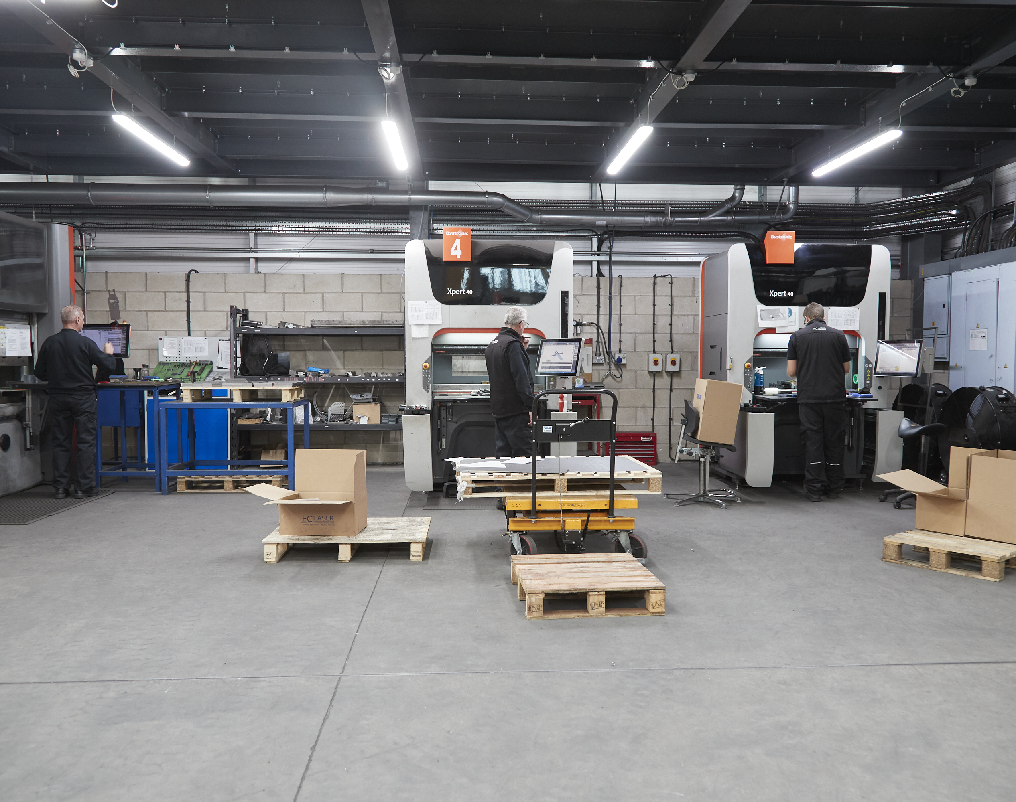
OUR FOLDING DIVISION
“Our highly efficient bending capacity, combined with the latest ERP systems puts FC Laser in a strong position to provide an unrivalled level of service, expertise, and solutions to our expanding customer base.”
Bystronic Xpert 320 – 4m Length & 320 tonne
Bystronic Xpert 150 – 3m Length & 150 tonne
Bystronic Xcite 80 – 2m Length & 80 tonne
2x Bystronic Xpert 40 – 1m Length

Slide 10
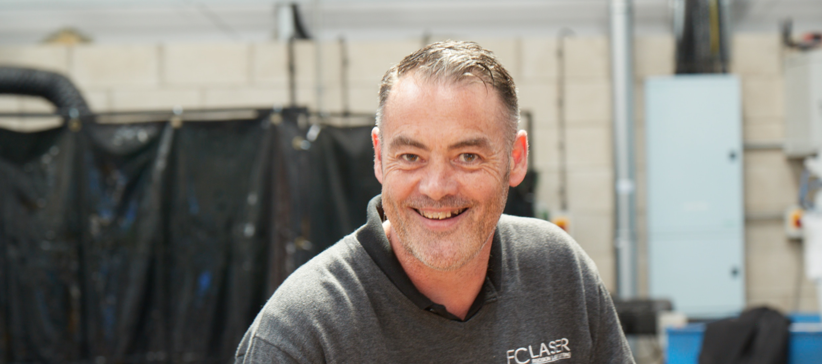
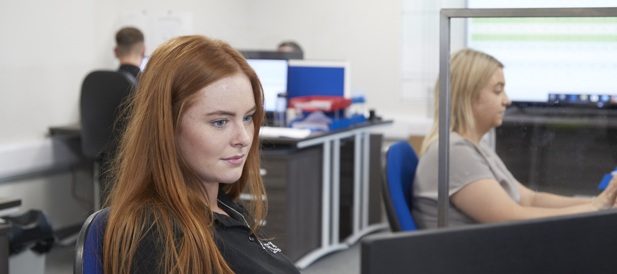
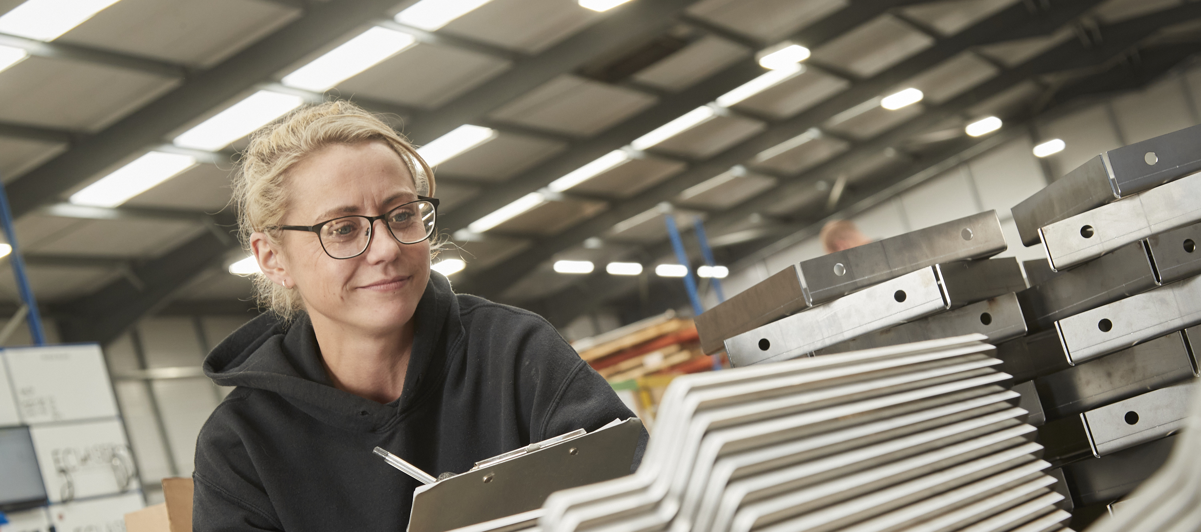
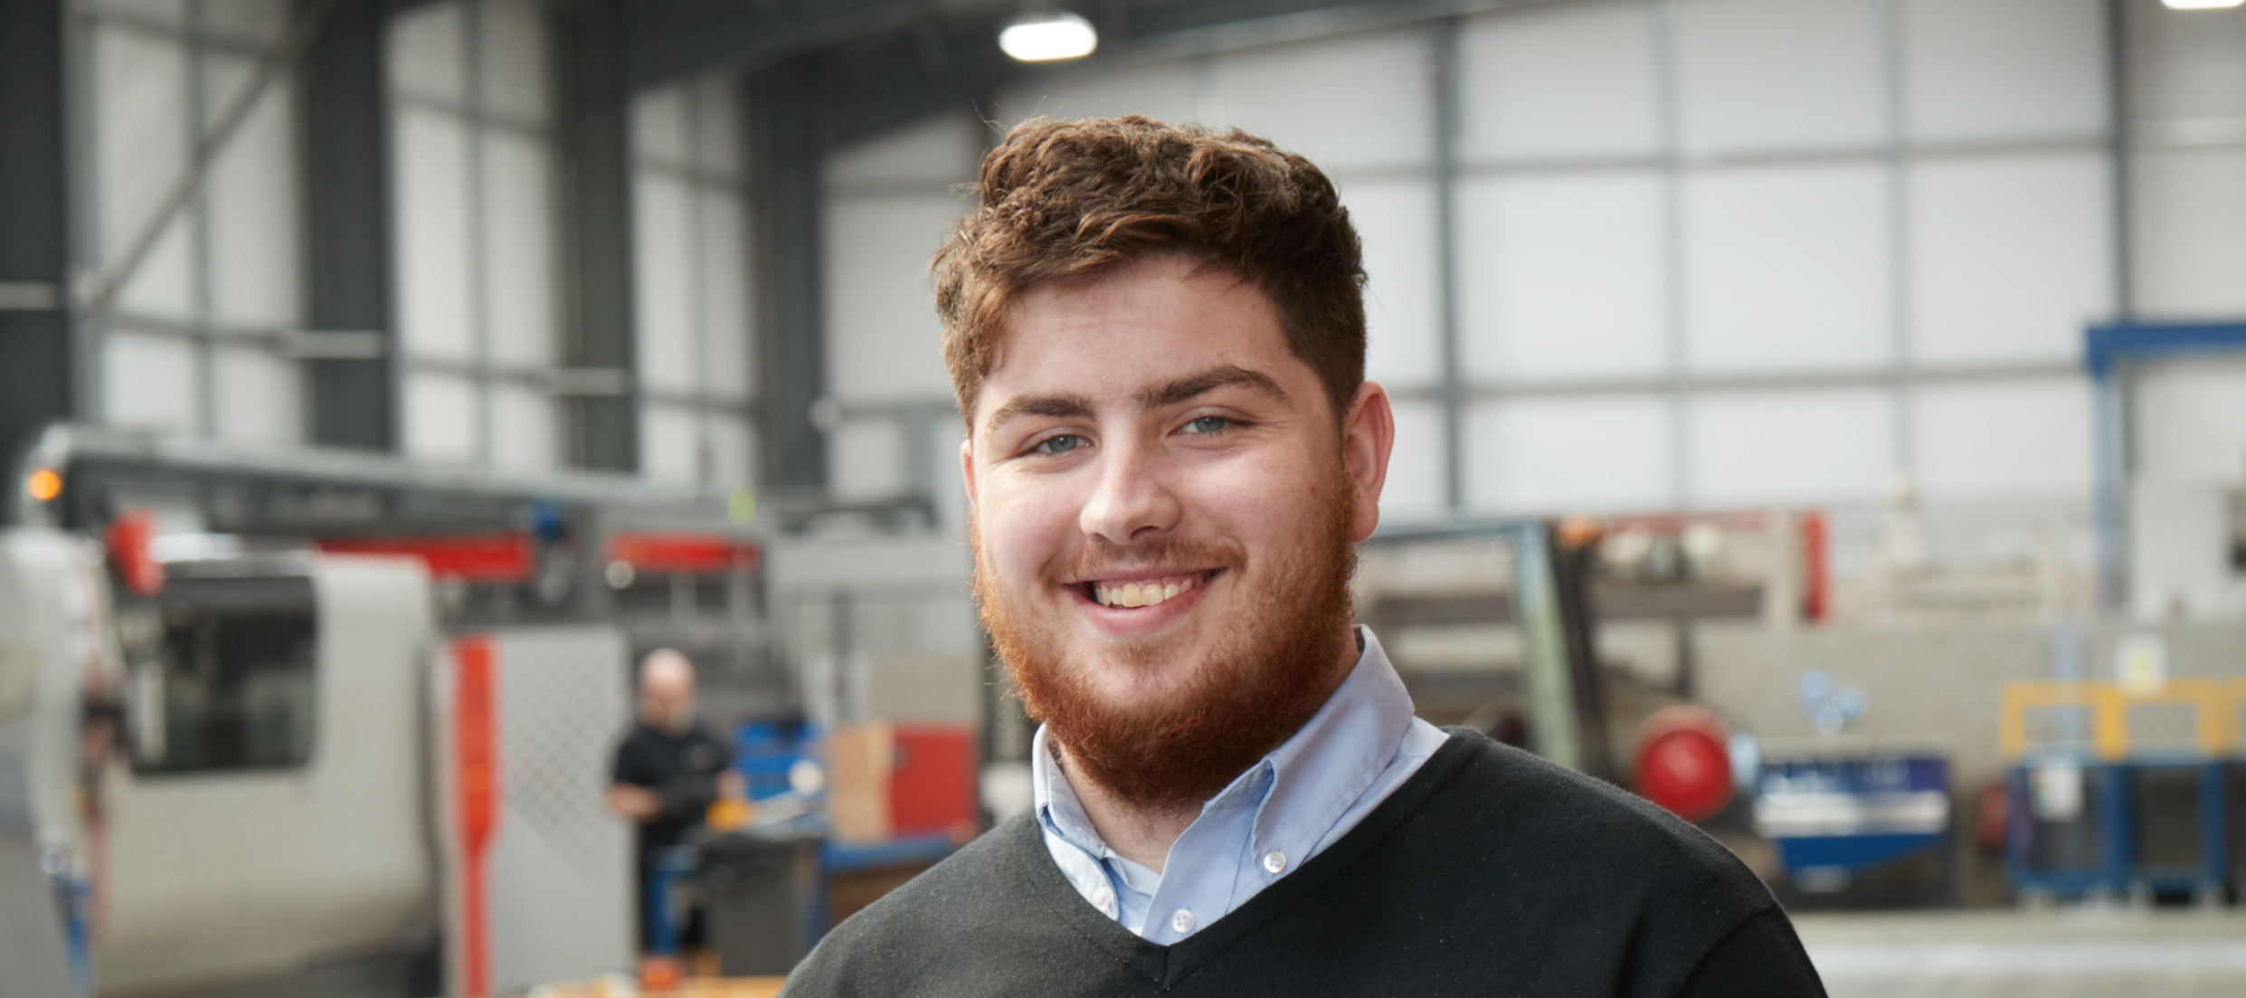
THE FC LASER DIFFERENCE
TRUE 24/7 CAPACITY
EMPLOYEE OWNED
MULTI YEAR PROJECT EXPERIENCE
ON SITE STORAGE FACILITY
R&D DEPARTMENT
STOCK HOLDING FOR TUBE
AND……… AMBITION

Slide 11
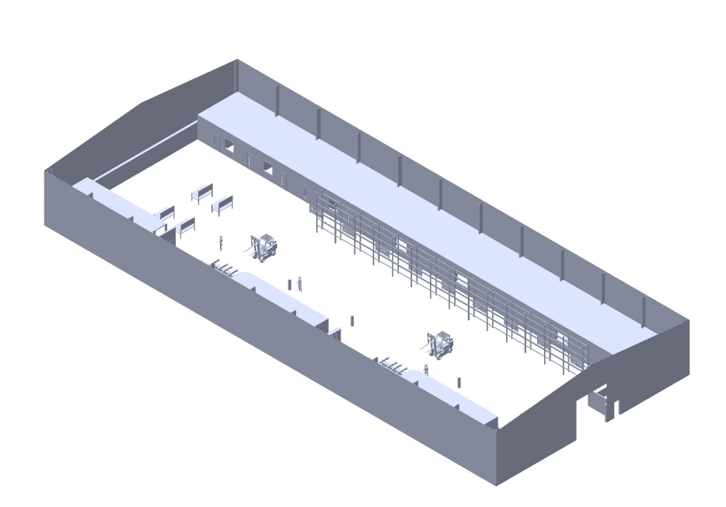
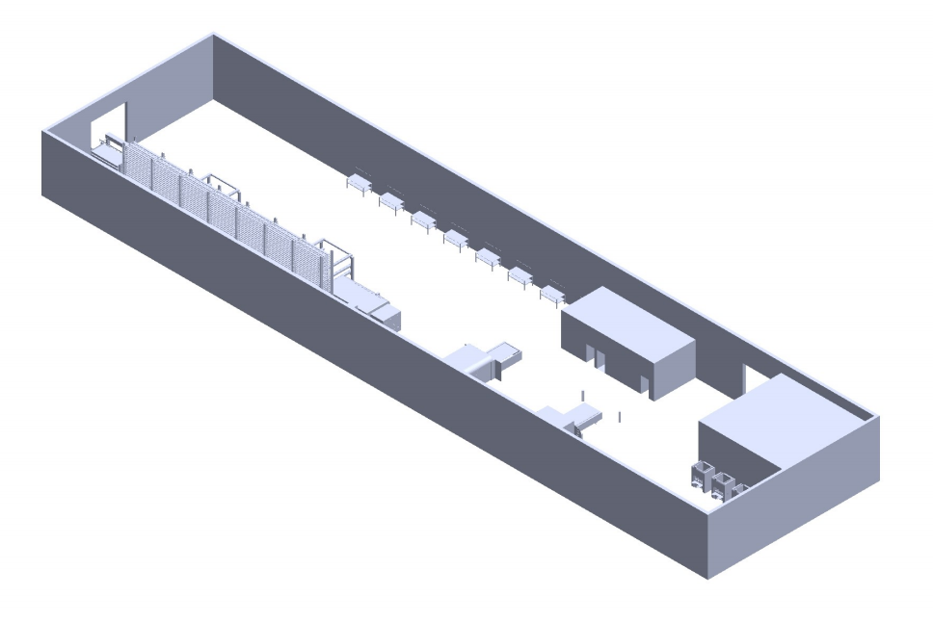
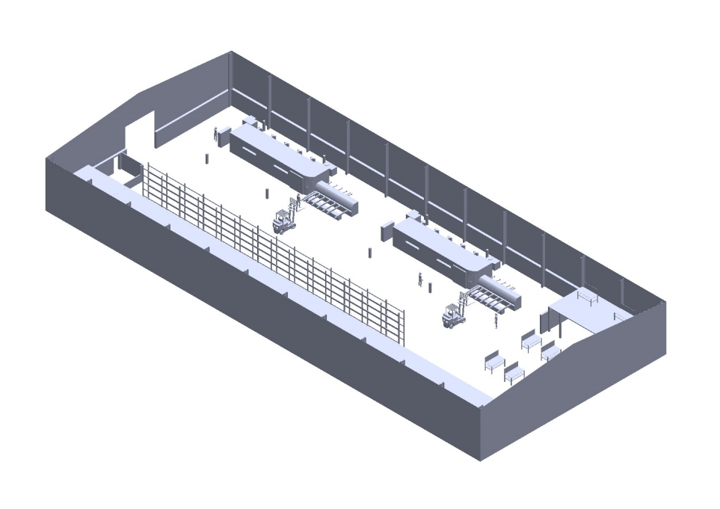
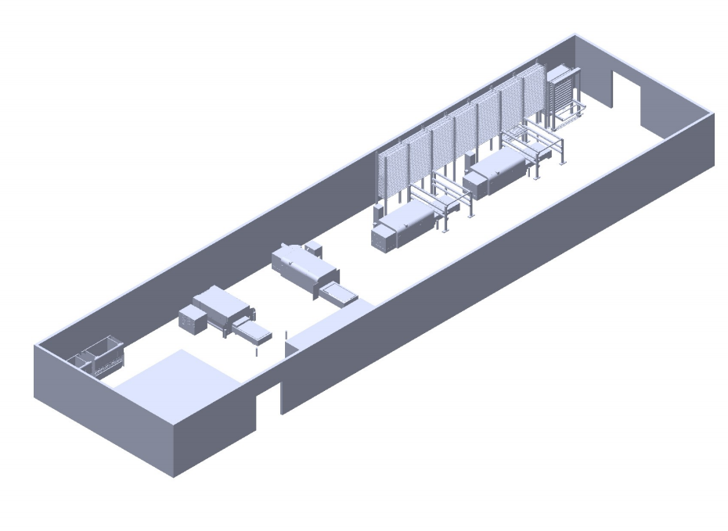
Expanded further operations bay
POWDERCOAT FACILITY
REDESIGNED SITE ONE
NEW BUILDING SITE TWO
AUTOMATED TOWER LOADING SYSTEM FOR OUR TWO 12KW BYSTAR LASERS
2ND 3D FIBRE LASER
OUR ADJOINING FACILITY DOUBLES OUR FOOTPRINT

Slide 12
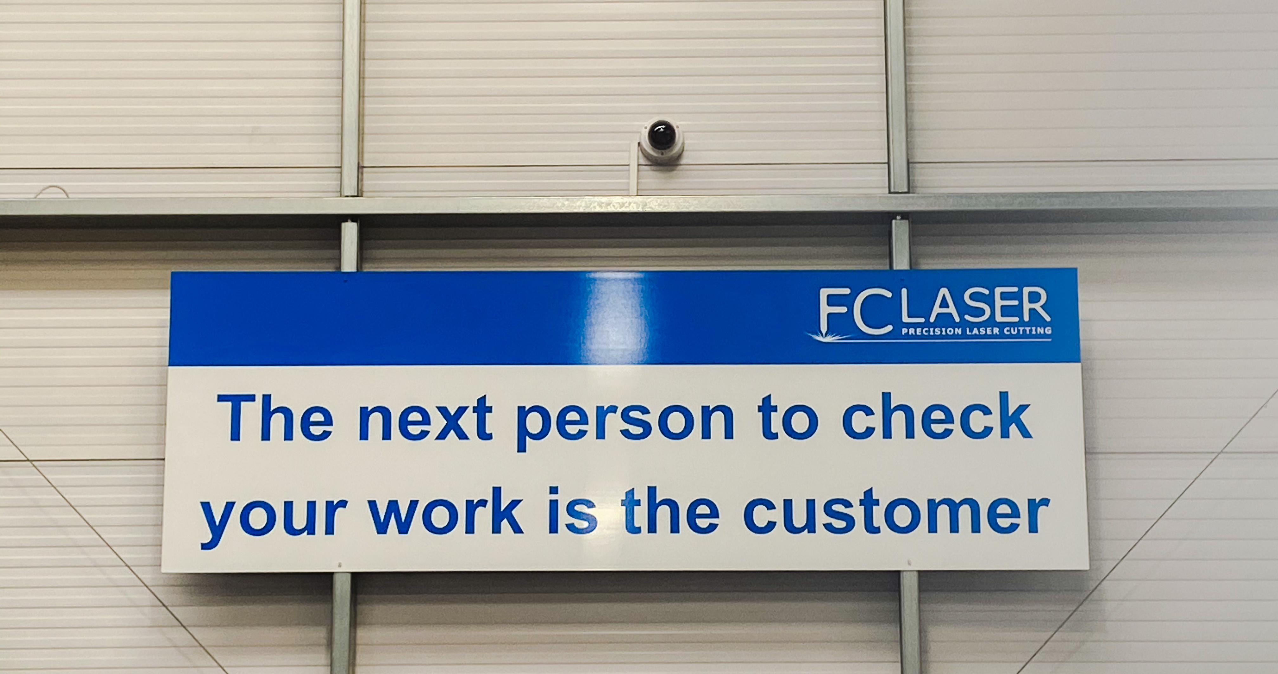
THANK YOU FOR LISTENING

